Slide 1
Lesson 7 – Code Testing

Slide 2
Lesson goals
What is code testing
Why we need it
How to write tests
Code coverage
Testing methodics

Slide 3
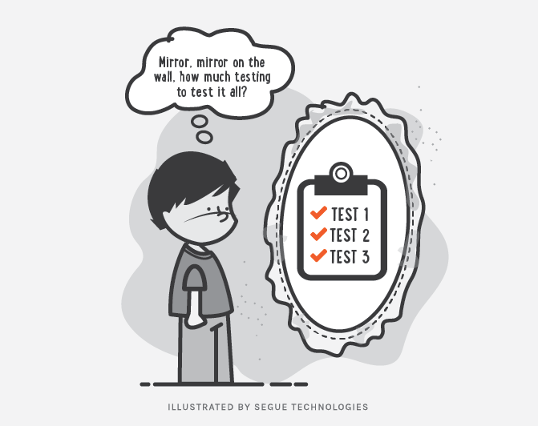
Code Testing

Slide 4
Importance
Scenario : “Let’s make a small fix!!!”

Slide 5
Importance
Scenario : “Let’s make a small fix!!!”
Action: Developer changes a “simple” line of code.

Slide 6
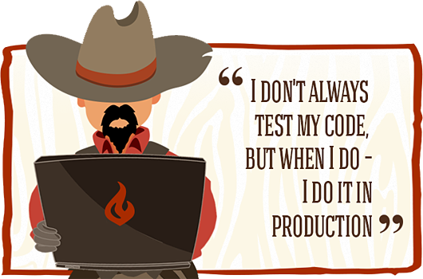
Importance
Scenario : “Let’s make a small fix!!!”
Action: Developer changes a “simple” line of code.
Result: This quick fix solve the problem but broke other parts of the program 😈

Slide 7
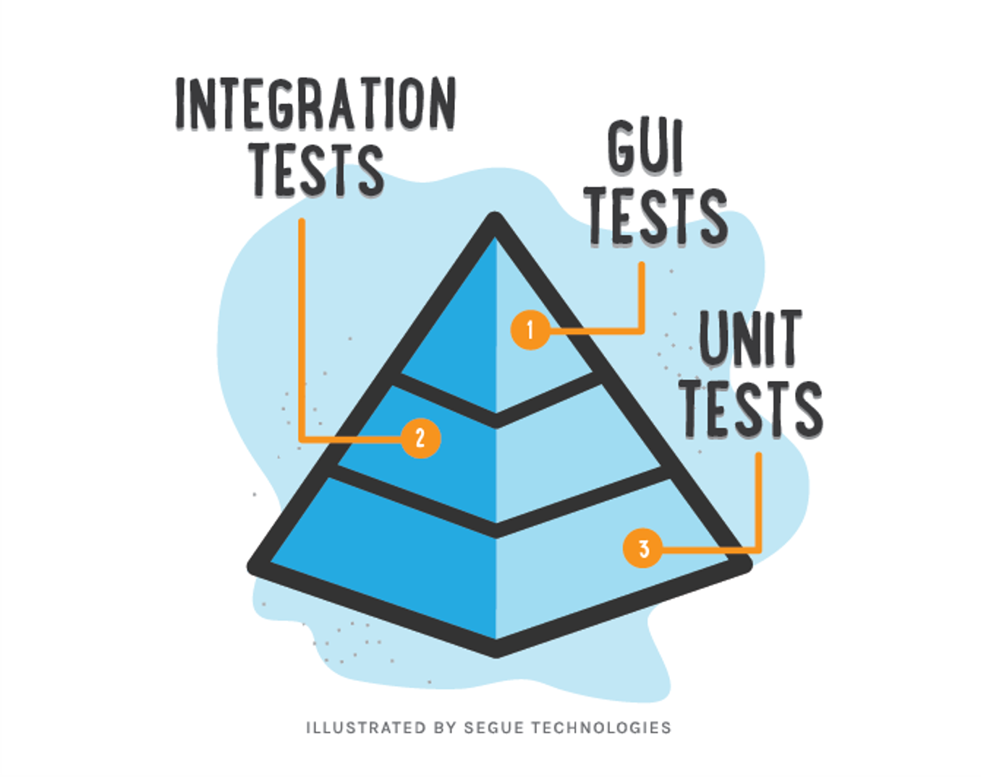
Testing levels aka “Testing Pyramid”
Manual Testing
$$$$
$

Slide 8
Pros vs Cons
Bugs preventing
Easy refactoring
Better code architecture
Documentation
Less debugging cases
Time saver
Money saver
Must have practice for big projects
Guarantee that your code is working as expected

Slide 9
Pros vs Cons
Bugs preventing
Easy refactoring
Better code architecture
Documentation
Less debugging cases
Time saver
Money saver
Must have practice for big projects
Guarantee that your code is working as expected
Needs more time for first coding
Require support
Possible overhead
Hard to write good tests
Hard to apply on legacy code

Slide 10


Testing libraries

Slide 12
Unit testing

Slide 13
Unit Test Example
package io.testsgh.unittestexample;
class Calculator {
int add(int x, int y) {
return x + y;
}
}
package io.testsgh.unittestexample;
import org.testng.annotations.Test;
import static org.testng.Assert.*;
public class CalculatorTest {
@Test
public void testAdd() {
Calculator calculator = new Calculator();
int actualResult = calculator.add(1, 2);
int expectedResult = 3;
assertEquals(actualResult,expectedResult);
}
}

Slide 14
How to setup & run tests
Setup:
Add test library to project
Run:
Directly from IDE (mostly used)
Via build system (Gradle task verification::test)
CI server to assure that nothing was broken

Slide 15

Working with IDE

Slide 16
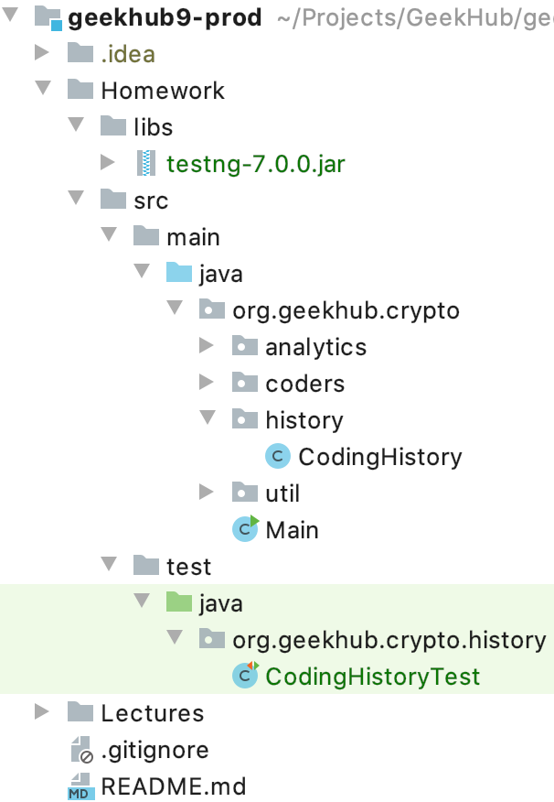
Test Source code convention

Slide 17
Code Convention in Tests
Test of class should be in same package in test source root
Tested class should have same name as tested class with suffix “Test”
Feature to be tested
Should_ExpectedBehavior_When_StateUnderTest
When_StateUnderTest_Expect_ExpectedBehavior
One convention for all tests

Slide 18
Tested method names patterns
Feature to be tested
IsNotAnAdultIfAgeLessThan18
FailToWithdrawMoneyIfAccountIsInvalid
StudentIsNotAdmittedIfMandatoryFieldsAreMissing

Slide 19
Tested method names patterns
Should_ExpectedBehavior_When_StateUnderTest
Should_ThrowException_When_AgeLessThan18
Should_FailToWithdrawMoney_ForInvalidAccount
Should_FailToAdmit_IfMandatoryFieldsAreMissing

Slide 20
Tested method names patterns
When_StateUnderTest_Expect_ExpectedBehavior
When_AgeLessThan18_Expect_isAdultAsFalse
When_InvalidAccount_Expect_WithdrawMoneyToFail
When_MandatoryFieldsAreMissing_Expect_StudentAdmissionToFail

Slide 21
Test results verification
assertEquals(Object o1, Object o2)
assertNotEquals(Object o1, Object o2)
assertTrue(boolean condition)
assertFalse(boolean condition)
assertNull(Object o)
assertNotNull(Object o)
more in org.testng.Assert.*

Slide 22
Test configurations
Usage of @BeforeMethod annotation
Usage of @AfterMethod annotation
public class CalculatorTest {
@Test
public void testAdd() {
Calculator calculator = new Calculator();
int actualResult = calculator.add(1, 2);
int expectedResult = 3;
assertEquals(actualResult, expectedResult);
}
}

Slide 23
Method that throws exceptions
public class EncodersFactory { public static Encoder getEncoder(Algorithm algorithm) { switch (algorithm) { case CAESAR: return new CaesarCodec(); case MORSE: return new MorseCodec(); case VIGENERE: default: throw new IllegalArgumentException(); } } }
Expected exception parameter for test method

Slide 24
Which code should be tested by Unit tests?
Yes
Business logic
Everything that contain conditions
No
Working with file system or DB
Working with some external services or internet

Slide 25
What you should not test
Other frameworks or libraries
Trivial code like “get/set”
Code that has non deterministic results (Think random numbers)

Slide 26
What is a good Unit test
Easy to understand
Easy to run
Repeatable
Has one logical assertion
Independent(Isolated)
Incremental
Test single unit
Maintainable
Fast
Informative (in case of fail)

Slide 27
Good practices
Limit bounds test cases (especial for user input)
Reset components before each test
Test success cases and fail cases separately
Dependency injection through constructor

Slide 28

Code Coverage

Slide 29
Test Driven Development

Slide 30
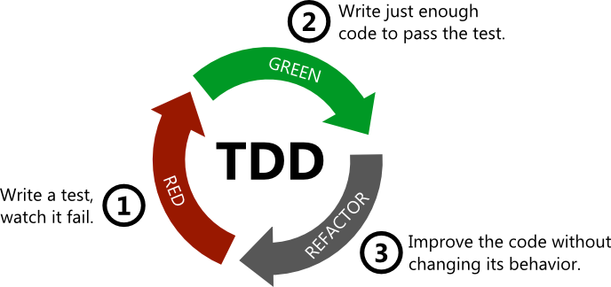
Test Driven Development

Slide 31
Homework
Clean Code: A Handbook of Agile Software Craftsmanship by Robert C. Martin : Chapter 9
Add TestNG 7.0.0. library to project
Write tests on existing codecs (Caesar, Morse, Vigenere)
Write tests on CodingAudit
Write tests on CodingHistory

Slide 32
Useful links
Add custom Library to IDEA
Best practices for unit testing
The Pros & Cons of Test-Driven Development
7 Popular Unit Test Naming

Slide 33

Thanks!
Any Questions?
Or find us in Slack:
@Yaroslav Brahinets
@Vasya Rudas
@Oleksandr Kucher

